Slide 1
Scattered Lands
Sprint 5
B. Todorow - G. Blazejowski - J. Ross - M. Grazia • 13/02/2025

Slide 2
Sprint Goals
User Interface - Place UI elements on Main Menu
Inventory System - Create inventory windows, cells and sort functionality
World Generator - Creating a flagging system to spawn elements on the map

Slide 3
Parallel Development:
Risultato 1
UI - Bogdan Todorow
Inventory - Gracjan Blazejoswki
World Generator - Marta Grazia, Joshua Ross

Slide 4
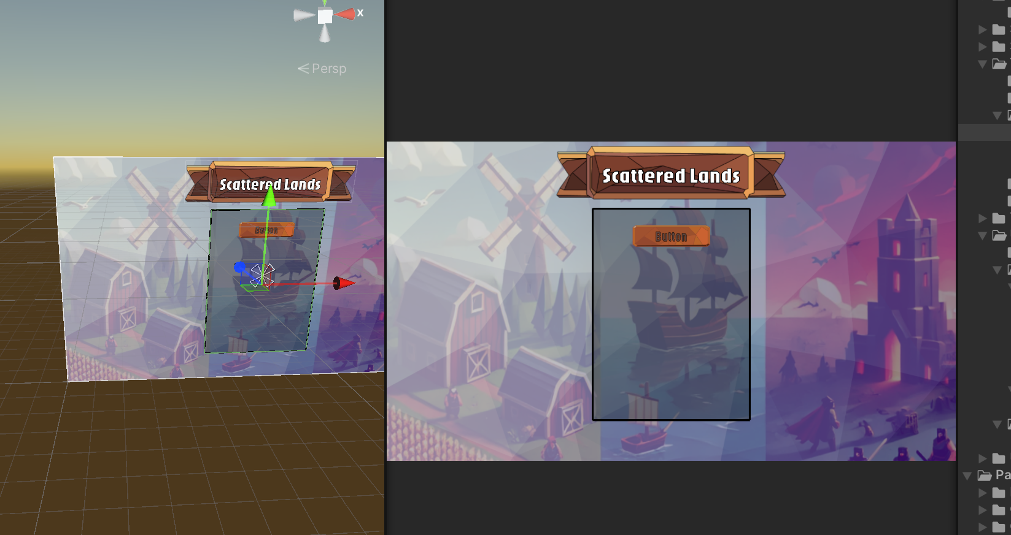
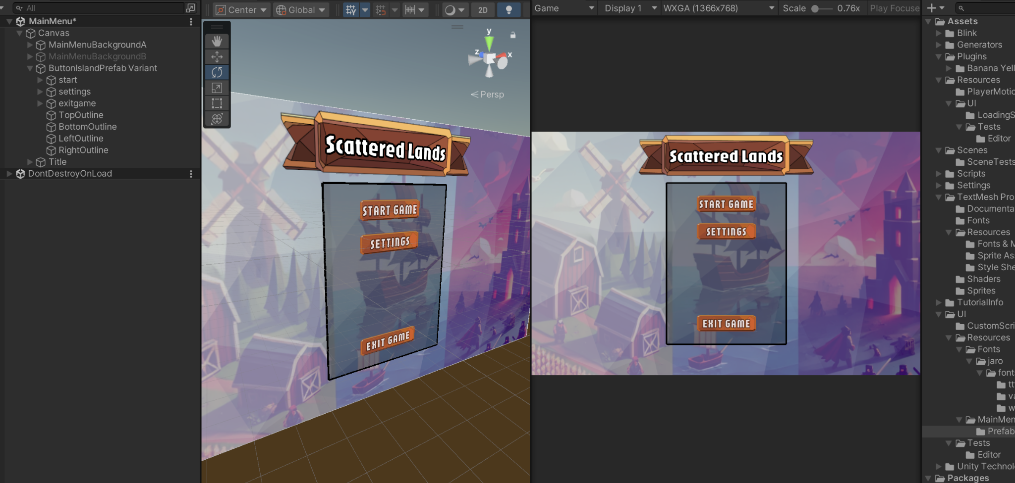
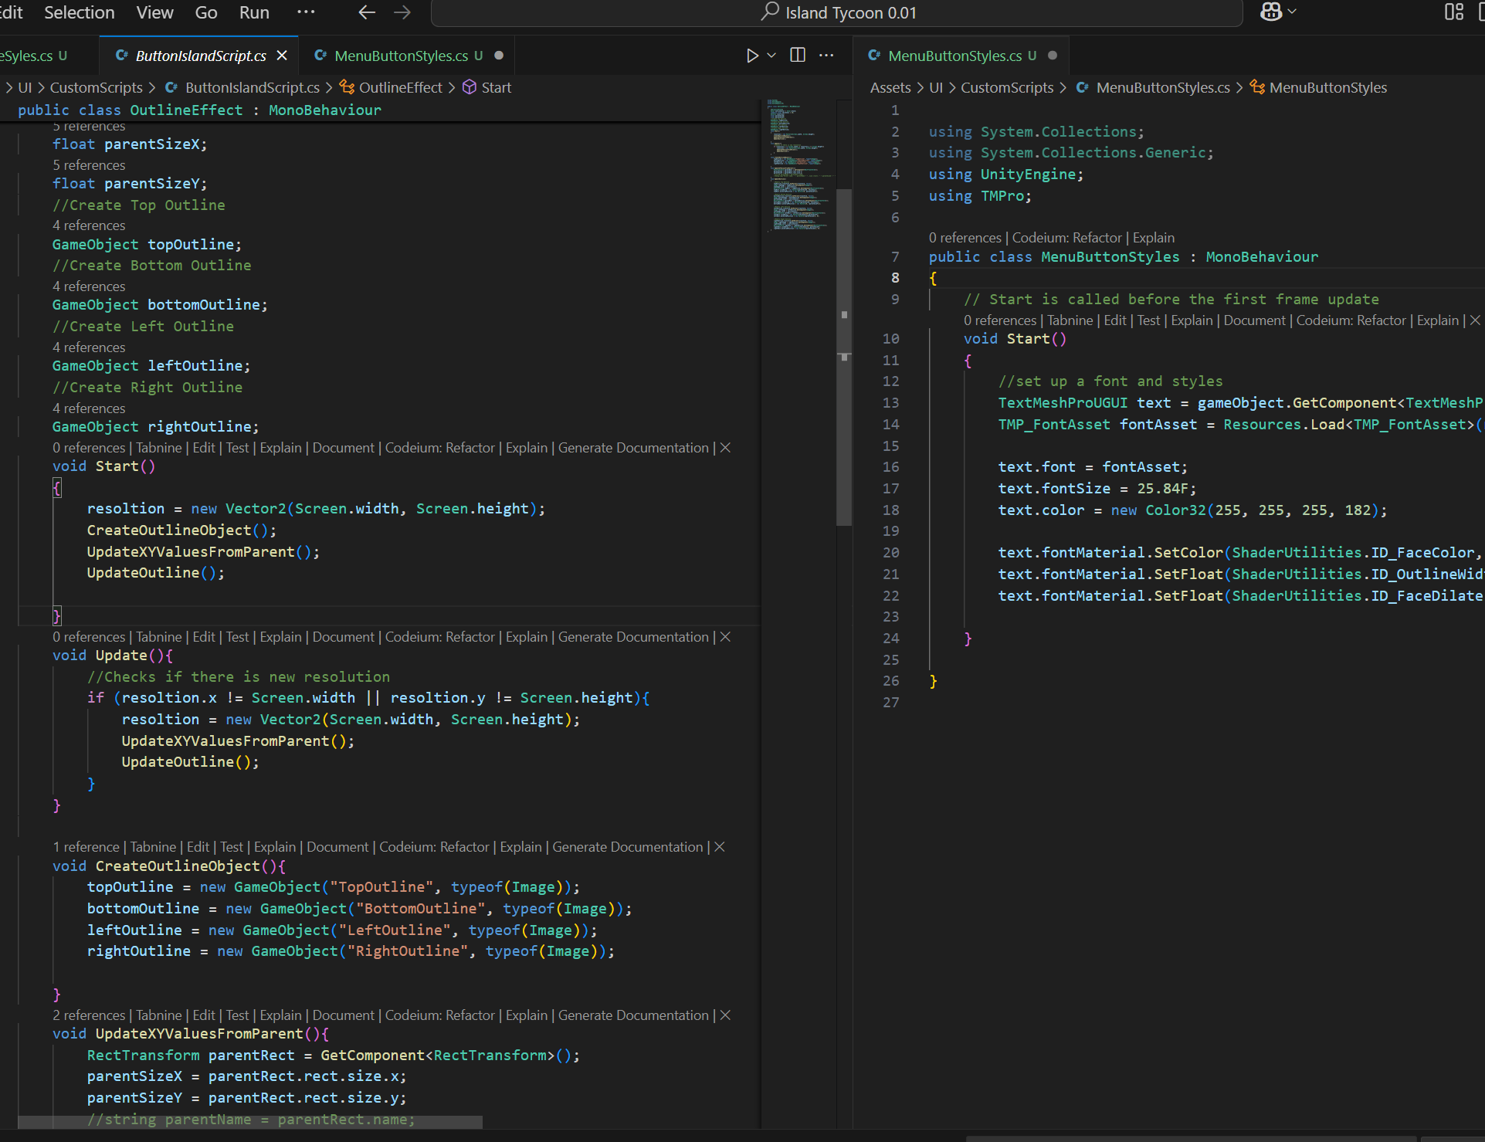
Progress - User Interface
Researched Unity UI and scripts
Fully resizable Menu Window
Customizable Fonts via Scripts

Slide 5
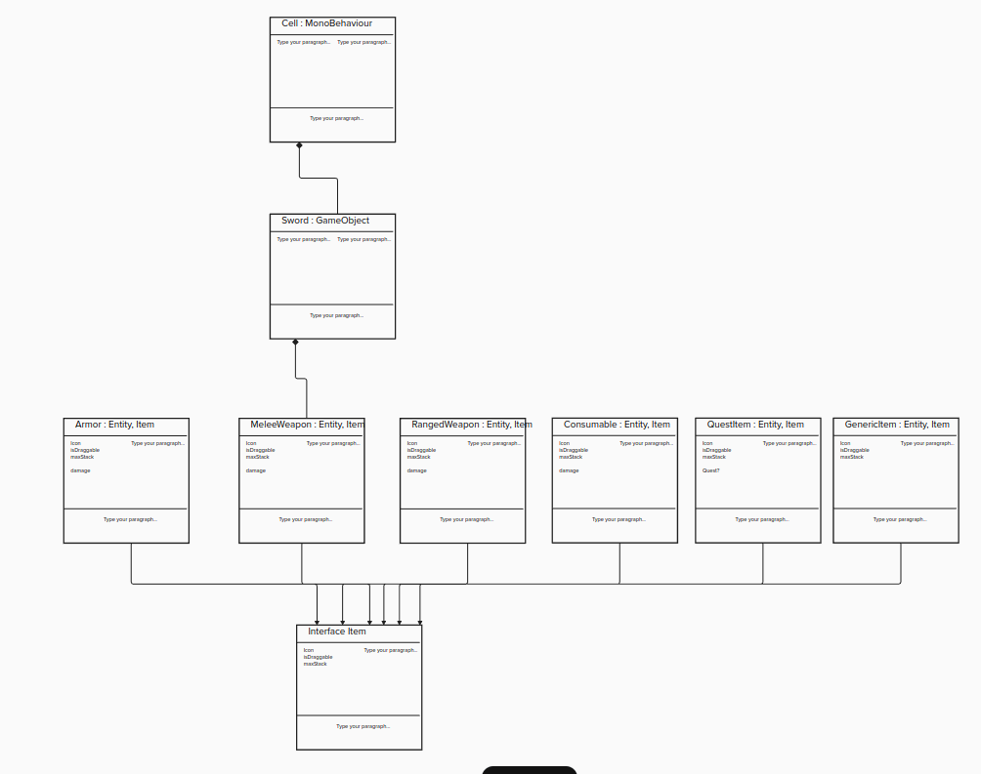

Progress - Inventory
General-purpose dragbar
Inventory Window
Gridded inventory cells
Draggable Items
Item Stacks
Event System
Click-and-drag vs Hold-and-drag

Slide 6
Progress - World Generator
Item Flagger System
Item Placement Component
Items are Spawned with randomized size and rotation

Slide 7
Moving Forward
User Interface
Implement UI Interactions
Inventory
Resolve interaction issues
World Gen
Implement Chunking

Slide 8
Thank you.

